Slide 1
Effective Portfolio Management with Kanban
Mahesh Singh/ Avinash Rao
Digité, Inc.

Slide 2
Agenda
Key Objectives of Portfolio Management
Challenges of traditional Portfolio Management
Features of Kanban that lend it to Portfolio Management
  Focus on Upstream
  Demand Shaping (and Capability balancing)
  Cost of Delay Function
  Delayed Decision-making
  Forecasting/ Simulation
  Visualization
  Scalability

Slide 3
Key Objectives of Portfolio Management
Bubble up the Right Strategy Ideas/ Initiatives to the top
Prioritize the Right Initiatives (at the Right Time)
Identify Ideas/ Requests/ Initiatives
Analyze and Prioritize
Align Strategy To Execution
Keep Stakeholders informed
Make Funding Go/ No Go Decisions
Provide insights into health of current Investments in play

Slide 4
Lets see how this usually works in practice
Executive pick the right set of projects and programs to fund (of course)
The projects and programs are allocated a budget based on the ROI they are expected to provide (always!)
These are then executed in a successful manner, which leads to the ROI and business objectives being met, which, of course, leads to a successful Portfolio (and we all get promoted!)

Slide 5
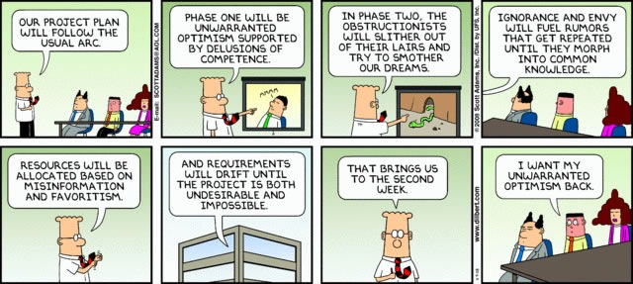
Dilbert: “Our Project Plan Will Follow the Usual Arc”
No? Doesn’t sound familiar?
Notes:
https://www.joeydevilla.com/2008/11/09/dilbert-our-project-plan-will-follow-the-usual-arc/

Slide 6
Lets see how this usually works in practice
But it isn’t necessarily the fault of the executives or the portfolio manager, or the execution teams.
Why not?

Slide 7
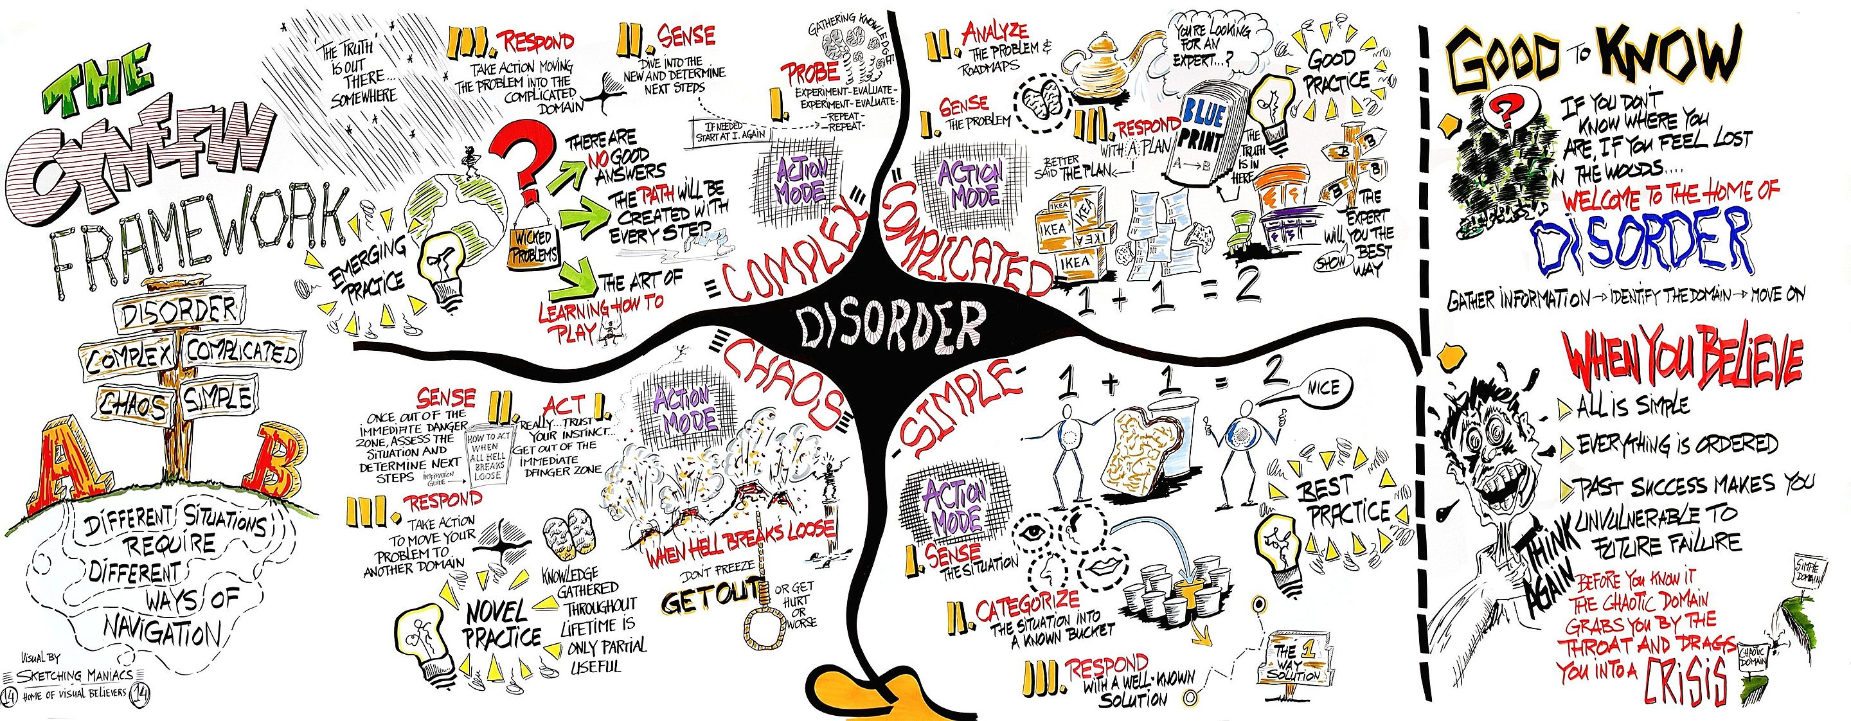
Portfolios are frequently Complex

Slide 8
Which means …
In today’s marketplace, there is ever increasing change and competition
Best or even Good practices are unlikely to lead to the desired outcomes
Complex portfolios need for us to Probe, Sense and Respond on an ongoing basis
This is different from the traditional instinct to plan and control (where you can sense, plan and respond) which works reasonably in Simple or even Complicated scenarios)

Slide 9
Is there no hope then?
To handle a portfolio of complex programs and projects, we need a way to plan and execute in shorter, incremental cycles
We need to be able to probe proactively and sense the progress of the individual tracks, and respond with interventions
These interventions can be additional support to re-align the progress, or early discard of the tracks where no progress is being made (or cost of progress is too high)

Slide 10
To achieve these, we need:
First, we need visibility into potential tracks in the portfolio, along with ongoing work
We need a way to evaluate on an ongoing basis the value of these tracks
Once commissioned, we need to understand the progress of each track, and impediments
Finally, we need to re-allocate to back winners and prune (potential) failures early

Slide 11
Key Features of Kanban that enable Portfolio Management
Lean Portfolio Management
  Planning in Shorter Horizons
  Data-based Forecasting/ Capacity Planning
Prioritization by Evaluating Opportunity Cost
  Cost of Delay
  Risk Profiling
Tracking, Monitoring, Aligning
  Dependency Management
  Forecasting/ What-if Analysis
Transparency of the Portfolio Lifecycle
  Visibility
  Accurate/ Easy Status Reporting
Alignment of Strategy to Execution
  Visibility to Leadership
  Effective Coordination
  Context/ Purpose for Teams
To Achieve

Slide 12
”But I thought Kanban is for IT/ Ops..?!”
Kanban is not just for IT/ Ops
Kanban is not just a “Ready – Doing – Done” Board
Kanban is Scalable – Vertically AND Horizontally

Slide 13
Lean/ Agile Portfolio Management
Shorter Planning Cycles
  Quarterly/ Monthly Planning
  Booking Capacity based on known Throughput/ Velocity & Probabilistic Forecasting
Feedback Loops and Frequent Adjustment cycles
  PDCA
  Probe, Sense, Respond
  Fail Fast, Fail Often

Slide 14
Prioritization – as delayed as possible
Delay decisions till the “last responsible moment”
  Selection of Options
  Funding
  Execution
Enable change in direction based on market forces
  Allow customers to change priorities
  Focus on the most important (top 5 or 10)
Avoid shelving / cancelling projects once initiated
  Discard instead of Abort

Slide 15
Discard, instead of Abort
Maximize Throughput!!
Abort
Discard/ Divert
Commitment Point
Notes:
So what does Upstream Kanban do? (Walk thru the image animation)
Creates greater understanding of Delivery team capacity/ capability
Helps them respect WIP Limits – both Min and Max
Gives a better understanding of Delivery Cadence – and hence more efficient Replenishment
Helps manage the biggest challenge Dev teams typically face – overburdening/ large backlogs
Ensures a smoother flow
Provides both sides strong reasons to stay invested in Kanban!!!

Slide 16
Prioritization – as delayed as possible
Cost of Delay
  How late can we start this initiative in order to minimize cost of delay?
    Too early a start can result in opportunity cost
    Too late a start usually results in missed windows of opportunity
  What is the Cost?
    Cost of Delay function
    Probability distribution of completion time (Lead Time)
Risk Profiling/ Demand Shaping
  What is the risk of doing/ not doing something?
  What is the organization’s risk appetite?
Upstream Kanban/ Patrick Stayeart

Slide 17
Tracking/ Monitoring/ Forecasting
Managing Dependencies
  Within and across teams
  Customer/ Supplier dependencies/ blockers
  Capacity/ Capability Bottlenecks
  Balancing Capacity and Demand
Forecasting
  Linear Regression
  Lead Time Distribution - Actual
  Lead Time Probability - Forecast

Slide 18
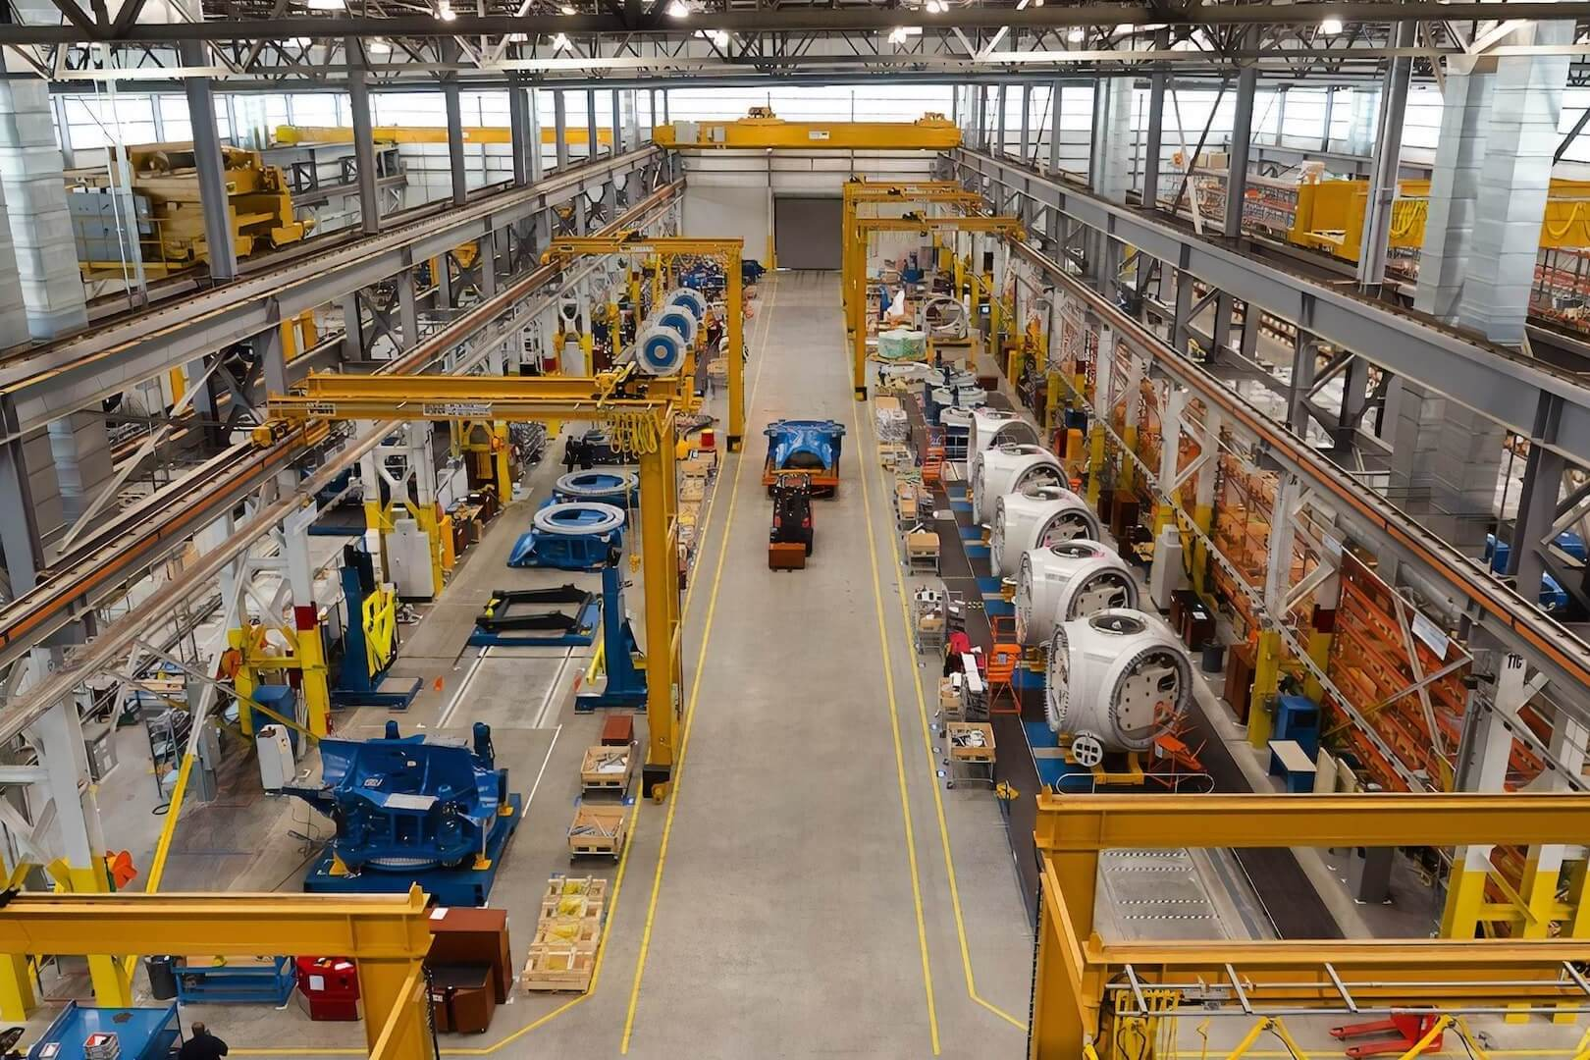
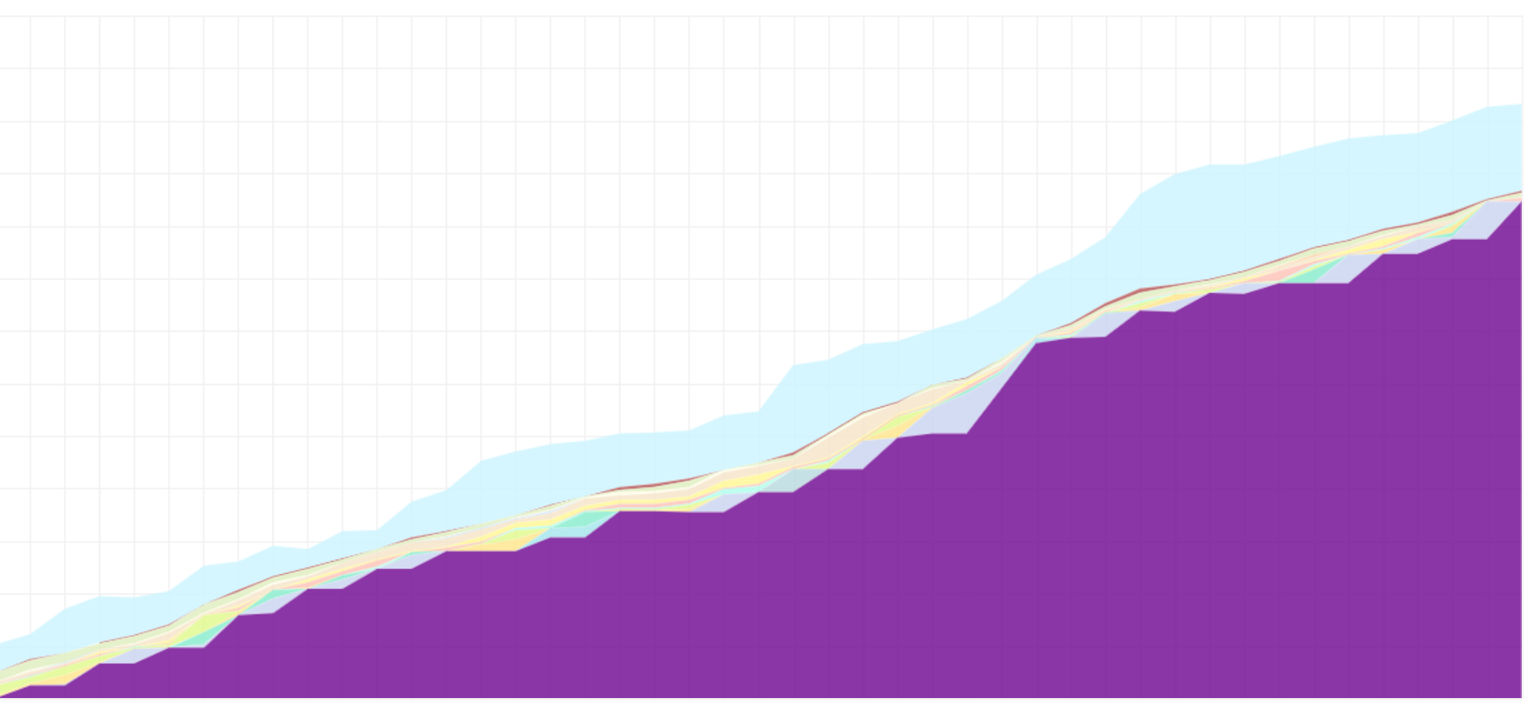
The Cost of Failure Keeps Going Up
Notes:
https://www.bluecart.com/blog/manufacturing-inventory

Slide 19
Transparency/ Visibility
Visualization at ALL levels
  Portfolio/ OKR → Program → Project → Tasks
  Theme → Epic → User Stories → Tasks
Simplified Status Rollup, based on
  Cards
  Tasks
  Effort
Interconnected Boards/ Swim Lanes
Flight Levels/ Klaus Leopold

Slide 20
True Alignment of Strategy to Execution
Visibility to Leadership
  “Are we on target with this OKR/ Initiative?”
  “How is it being executed?”
  “What has been completed? In-flight? Delayed?”
Context to Delivery Teams
  ”Why are we doing what we are doing?”
  “What is the purpose of this?”
Effective Coordination
  Program Boards (Flight Level 2)

Slide 21
A Quick Demo: Portfolio Management with SwiftKanban
Aligning Strategy to Execution

Slide 22
Questions?

Slide 23
Thank you!
Mahesh Singh
Co-founder, SVP – Marketing/ Consulting
AKT/ AKC
https://www.digite.com/swiftkanban
@maheshsingh
mahesh@digite.com
+1 (408)761-2238
https://www.linkedin.com/in/singhmahesh/

